Slide 1
FlowNet: Learning Optical Flow with Convolutional Networks
Sharon Anna Thomas
Supervisor : Azin Jahedi
30 Jun 2020

Slide 2
Outline
Motivation
Approach
Network Architectures
Training Data
Experiments
Results and Discussion
Conclusion

Slide 3
Outline
Motivation
Approach
Network Architectures
Training Data
Experiments
Results and Discussion
Conclusion

Slide 4
Motivation
Convolutional neural networks - method of choice in many fields of computer vision.
Classification
Semantic segmentation
Train CNNs end to-end to learn predicting the optical flow field from a pair of images
Existing ground truth data sets are not large enough for training,
generate a large synthetic Flying Chairs dataset.

Slide 5
Outline
Motivation
Approach
Network Architectures
Training Data
Experiments
Results and Discussion
Conclusion

Slide 6
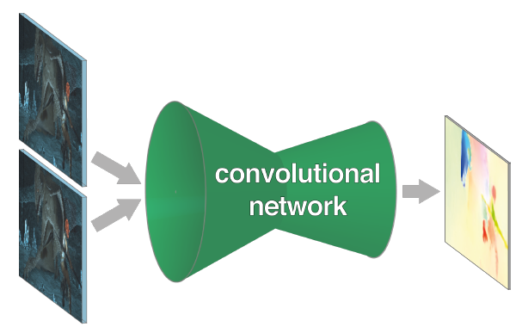
Neural networks which learn to estimate optical flow
Learn image representations as well as match them at different locations in the two images.
Provided a correlation layer – matching capabilities
The information is spatially compressed in a contractive part and then refined in an expanding part.
Network consists of expanding and contracting part
Author: Fischer et. al
Notes:
The idea is to exploit the ability of convolutional networks to learn strong features at multiple levels of scale and abstraction and to help it with finding the actual correspondences based on these features.

Slide 7
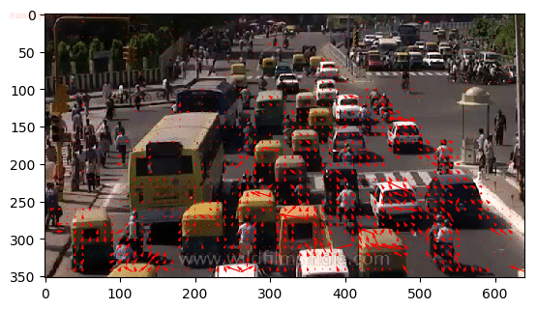
Optical Flow
Track the motion of objects across frames - predict position in the next frame
Assumption - color/intensity of a pixel is invariant from one video frame to the next.
Sparse optical flow of traffic (Each arrow points in the direction of predicted flow of the corresponding pixel).
Source: https://nanonets.com/blog/optical-flow/
Notes:
Track the motion of objects across frames to estimate its current velocity and predict its position in the next frame

Slide 8
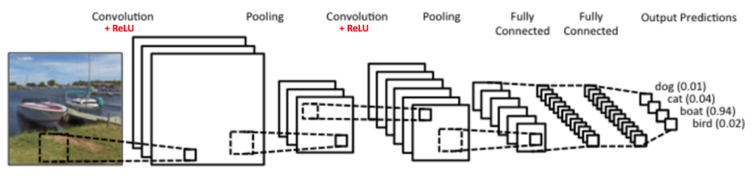
Convolutional Neural Networks
A convolutional neural network (CNN, or ConvNet) is a class of deep neural networks, most commonly applied to analyzing visual imagery.
There are four main operations in the ConvNet:
1
2
4
3
CNN for classification
Source: https://ujjwalkarn.me/2016/08/11/intuitive-explanation-convnets/

Slide 9
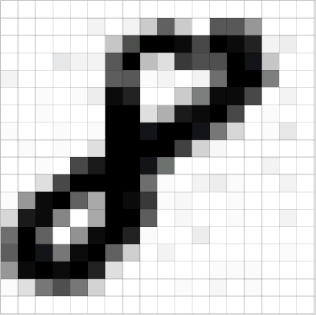
Convolutional Neural Networks
Every image can be represented as a matrix of pixel values.
image from a standard digital camera will have three channels red, green and blue
three 2d-matrices stacked over each other
Grayscale - single 2d matrix representing an image.
zero indicating black and 255 indicating white.
Grayscale image
Source: https://ujjwalkarn.me/2016/08/11/intuitive-explanation-convnets/
Notes:
three 2d-matrices stacked over each other (one for each color), each having pixel values in the range 0 to 255
The value of each pixel in the matrix will range from 0 to 255 –

Slide 10


Convolutional Neural Networks 1. Convolution
The primary purpose - extract features from the input image.
Slide the orange matrix over original image (green) by 1 pixel (also called ‘stride’)
For every position, compute element wise multiplication (between the two matrices).
Add the multiplication outputs to get the final integer which forms a single element of the output matrix (pink)
Convolution
Source: https://ujjwalkarn.me/2016/08/11/intuitive-explanation-convnets/

Slide 11
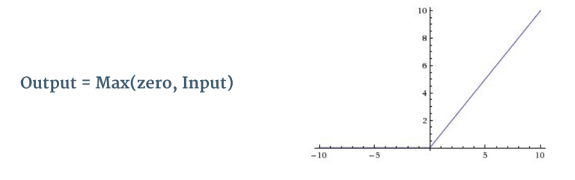

Convolutional Neural Networks 2. Non Linearity (ReLU)
ReLU is an element wise operation (applied per pixel) and replaces all negative pixel values in the feature map by zero
The purpose of ReLU is to introduce non-linearity in our ConvNet
ReLU
Source: https://ujjwalkarn.me/2016/08/11/intuitive-explanation-convnets/

Slide 12
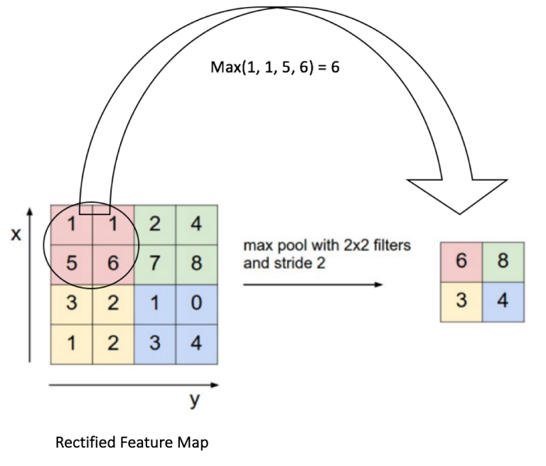
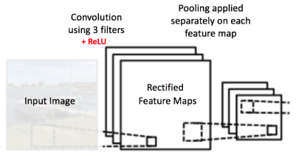
Convolutional Neural Networks 3. Pooling or Sub Sampling
Spatial Pooling (also called subsampling or downsampling) reduces the dimensionality of each feature map but retains the most important information.
In case of Max Pooling, we define a spatial neighborhood (for example, a 2×2 window) and take the largest element from the rectified feature map within that window
Pooling
Source: https://ujjwalkarn.me/2016/08/11/intuitive-explanation-convnets/
Notes:
In the network shown in Figure 11, pooling operation is applied separately to each feature map (notice that, due to this, we get three output maps from three input maps).
makes the input representations (feature dimension) smaller and more manageable
makes the network invariant to small transformations, distortions and translations in the input image

Slide 13
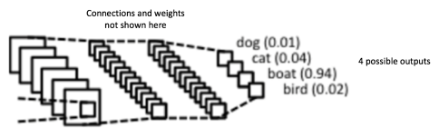
Convolutional Neural Networks 4. Classification (Fully Connected Layer)
Classify the input image into various classes based on the training dataset.
Combinations of features might be even better
Each node is connected to every other node in the adjacent layer
Classification
Source: https://ujjwalkarn.me/2016/08/11/intuitive-explanation-convnets/

Slide 14
Outline
Motivation
Approach
Network Architectures
Training Data
Experiments
Results and Discussion
Conclusion

Slide 15
Network Architectures
End to end learning approach to predicting optical flow
Dataset – image pairs and ground truth flows
Pooling
Computationally feasible
Aggregation of information
Reduced resolution
Need dense-per-pixel resolution
Networks consist of contracting and expanding part
Trained using backpropagation
Notes:
But pooling results in reduced resolution, so in order to provide dense per-pixel predictions we need to refine the coarse pooled representation

Slide 16
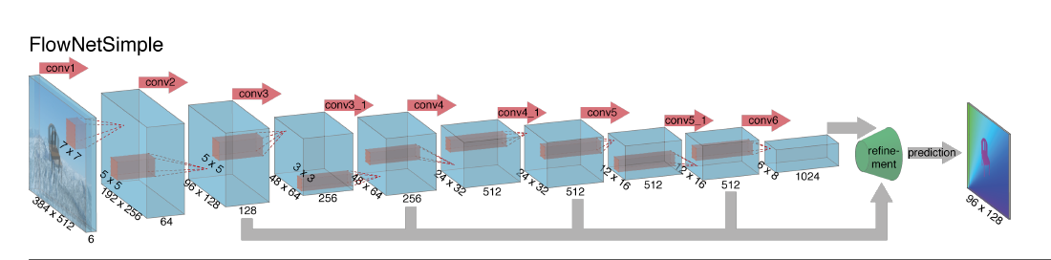
Contracting part – FlowNetSimple
FlowNetSimple
Author: Smagt et. al
Stack both input images
Network decides how to process the image pair
Only consists of convolutional layers
Notes:
simple choice is to stack both input images together and feed them through a rather generic network, allowing the network to decide itself how to process the image pair to extract the motion information.
Only consists of convolutional layers

Slide 17
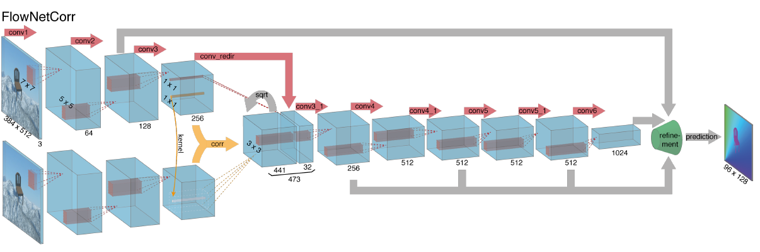
Contracting part – FlowNetCorr
FlowNetCorr
Author: Smagt et. al
2 separate identical processing streams
Combine on a higher level
Given feature representations – find correspondences?
Introduce correlation layer

Slide 18
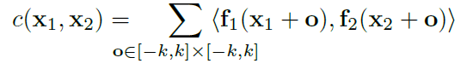
Contracting Part - FlowNetCorr
Correlation layer performs multiplicative patch comparisons between two feature maps.
Given
two multi-channel feature maps f1, f2
w, h, and c - width, height and number of channels
each patch from f1 compared with each patch from f2
‘Correlation’ of two patches centred at x1 and x2:
x1 and x2 are the center of the first map and the second map respectively
square space patch of size K = 2k+1

Slide 19
Contracting Part - FlowNetCorr
c(x1,x2) involves c . K² multiplications
Comparing all patch combinations involves w² . h² computations
Limit maximum displacement for comparisons
For each location x1, limit the range of x2
Compute correlations in a neighbourhood of size D = 2d+1
d is a given maximum displacement
size of an output is (w*h*D²)
Notes:
Then it is explained that these amount
of computations are (computationally) expensive and for each patch in f1,
only D2 (instead of w h) correlations will be computed, so the number
of correlation computations is reduced to (w h) D2.

Slide 20
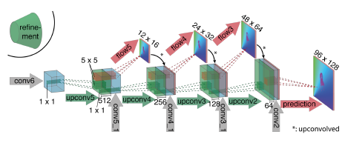
Expanding Part
Expanding part
Author: Smagt et. al
Expanding – ‘upconvolutional layers’
Unpooling and convolution
To perform refinement:
Apply ‘upconvolution’ to feature maps
Concatenate with corresponding feature maps from the ‘contractive’ part of the network
Notes:
This way we preserve both the high-level
information passed from coarser feature maps and fine local
information provided in lower layer feature maps.

Slide 21
Variational Refinement
Start at 4 times downsampled resolution
use the coarse to fine scheme with 20 iterations to bring the flow field to full resolution.
Run 5 more iterations at the full image resolution
Compute image boundaries
Replace smoothness coefficient by α = exp(-λb(x,y)^{κ})
b(x,y) – thin boundary strength
Obtain smooth and sub-pixel accurate flow fields

Slide 22
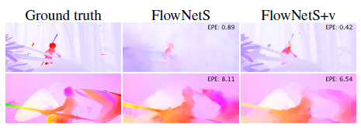
Variational Refinement
The effect of variational refinement.
In case of small motions (first row) the predicted flow is changed dramatically. For
larger motions (second row), big errors are not corrected, but the flow field is smoothed, resulting in lower EPE.
Author: Fischer et. al

Slide 23
Outline
Motivation
Approach
Network Architectures
Training Data
Experiments
Results and Discussion
Conclusion

Slide 24
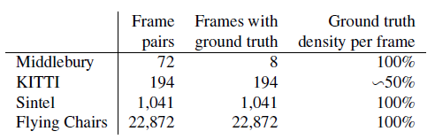
Existing Datasets
Middlebury – 8 image pairs with ground truth flows generated using 4 different techniques
Displacements are very small
KITTI – large displacements
GT obtained by simultaneously recording the scenes with a camera and a 3D laser scanner
MPI Sintel – provides dense ground truth for small and large displacement magnitudes
Final – motion blur and atmospheric effects such as fog
Clean – does not include these

Slide 25
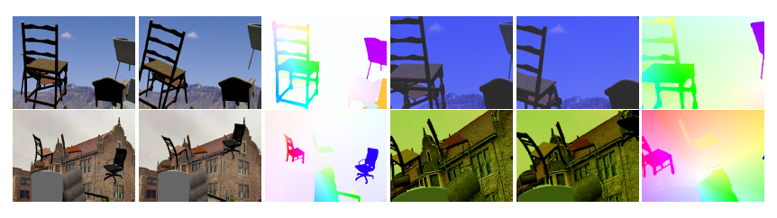
Existing datasets – Flying Chairs
Flying Chairs
Author: Fischer et. al
Synthetic dataset
Apply affine transformations to images from Flickr and set of renderings of 3D chair models.
Randomly sample 2D affine transformation parameters – used to generate second image, ground truth optical flow and occlusion regions
Data augmentation – crucial to avoid overfitting
Translations, rotation, scaling, additive Guassian noise etc

Slide 26
Outline
Motivation
Approach
Network Architectures
Training Data
Experiments
Results and Discussion
Conclusion

Slide 27
Network and Training details
Stride 2, ReLU non-linearity after each layer
Convolutional filter sizes decreases towards deeper layers
Number of feature maps increases in the deeper layers
Correlation layer in FlowNetC
k =0, d= 20,s1=1,s2=2
Training Loss – EPE (endpoint error)
Euclidean distance between predicted flow vector and GT, averaged over all pixels
To monitor overfitting, split dataset into training and test samples

Slide 28
Adam Optimizer
Adam is different to classical stochastic gradient descent.
A learning rate is maintained for each network weight (parameter) and separately adapted as learning unfolds.
β₁=0.9 and β₂=0.999
Mini-batches of 8 image pairs
Start with λ = 1e-4, divide by 2 for every 100k iterations after the first 300k
FlowNetCorr – exploding gradients with λ = 1e-4
Start with λ = 1e-6, slowly increase to reach λ = 1e-4 after 10k iterations
Notes:
Stochastic gradient descent maintains a single learning rate (termed alpha) for all weight updates and the learning rate does not change during training.

Slide 29
Fine tuning
Fine-tune on target datasets
Sintel training set chosen for fine-tuning
Use images from Clean and Final versions
Low learning rate of λ = 1e-6 for several thousand iterations
Best performance
Defining optimal number of iterations using validation set and then fine tune on the whole training set
Notes:
The used datasets are very different in terms
of object types and motions they include

Slide 30
Outline
Motivation
Approach
Network Architectures
Training Data
Experiments
Results and Discussion
Conclusion

Slide 31
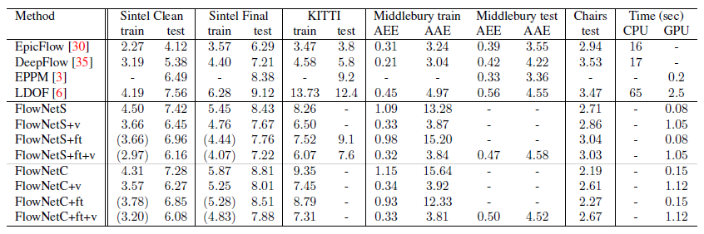
Results
Average endpoint errors (in pixels) of our networks compared to several well-performing methods
on different datasets.
Author: Fischer et. al

Slide 32
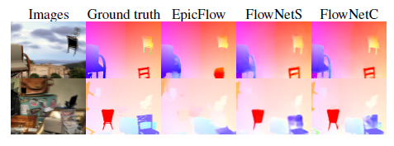
Results
Examples of optical flow prediction on the Flying Chairs dataset
Author: Fischer et. al
Is data augmentation necessary even after using a fairly large dataset such as Flying Chairs?
FlowNetC slightly more overfits to training data
FlowNetC has more problems with large dispalcements
Notes:
The answer is positive: training
a network without data augmentation on the Flying Chairs
results in an EPE increase of roughly 2 pixels when testing
on Sintel.
First, FlowNetS generalizes to Sintel Final better than
FlowNetC. On the other hand, FlowNetC outperforms
FlowNetS on Flying chairs and Sintel Clean. Note that Flying
Chairs do not include motion blur or fog, as in Sintel
Final.
This can be seen from the results
on KITTI discussed above, and also from detailed performance
analysis on Sintel Final

Slide 33
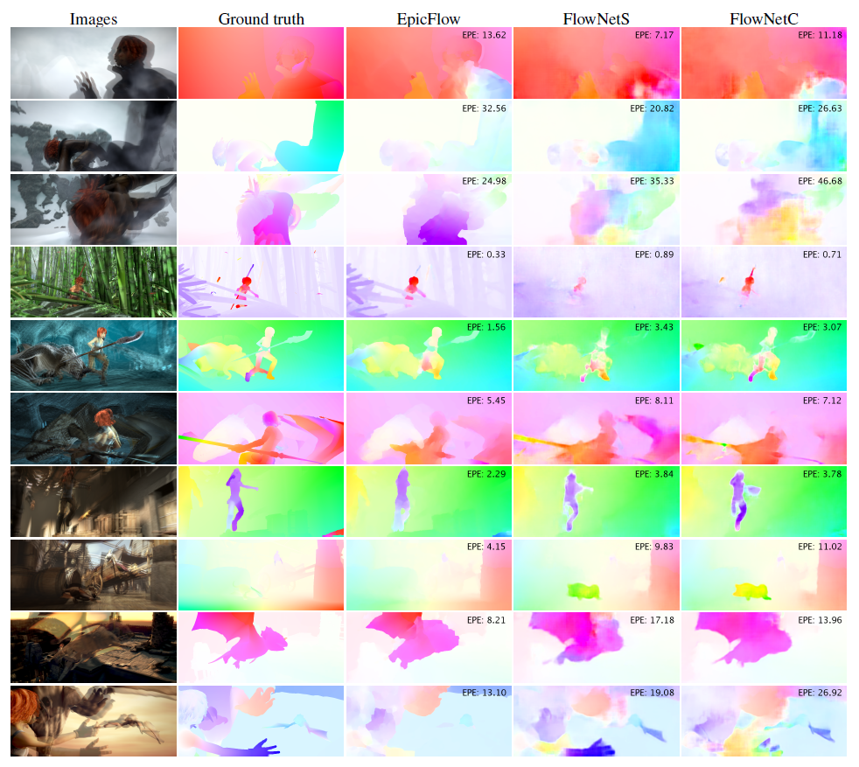
Results
Examples of optical flow prediction on the Sintel dataset
Author: Fischer et. al

Slide 34
Outline
Motivation
Approach
Network Architectures
Training Data
Experiments
Results and Discussion
Conclusion

Slide 35
Conclusion
Train a CNN network to directly predict optical flow from two input images
Training data need not be realistic
artificial Flying Chairs dataset including just affine motions of synthetic rigid objects predicts optical flow in natural scenes with competitive accuracy.
Proves the generalization capability
CNNs even outperform state-of-the-art methods like DeepFlow and EpicFlow.

Slide 36
References
A. Dosovitskiy, P. Fischery, E. Ilg, P. H¨ausser, C. Hazırbas¸, V. Golkov, P. Smagt, D. Cremers, T. Brox: FlowNet: Learning Optical Flow with Convolutional Networks.
Ujjwalkaran: ‘An Intuitive Explanation of Convolutional Neural Networks’: https://ujjwalkarn.me/2016/08/11/intuitive-explanation-convnets/
D. P. Kingma and J. Ba. Adam: A method for stochastic optimization. In ICLR, 2015.
T. Brox and J. Malik. Large displacement optical flow: descriptor matching in variational motion estimation. PAMI, 33(3):500–513, 2011
M. Leordeanu, R. Sukthankar, and C. Sminchisescu. Efficient closed-form solution to generalized boundary detection. ECCV’12.
A. Dosovitskiy, J. T. Springenberg, and T. Brox. Learning to generate chairs with convolutional neural networks. In CVPR, 2015

